Slide 1
The Battle of Neighborhoods - Finding a Better Place in Scarborough, Toronto
Capstone Project
@mdr

Slide 2
Introduction:
The purpose of this Project is to help people in exploring better facilities around their neighborhood
This Project aim to create an analysis of features for a people migrating to Scarborough to search a best neighborhood as a comparative analysis between neighborhoods.
The features include median housing price and better school according to ratings, crime rates of that area, road connectivity, weather conditions, good management for emergency etc.
It will help people to get awareness of the area and neighborhood before moving to a new city, state, country or place for their work or to start a new fresh life

Slide 3
Data Selection
Data Link: https://en.wikipedia.org/wiki/List_of_postal_codes_of_Canada:_M
Scarborough dataset which was scrapped from Wikipedia is used. Dataset consisting of latitude and longitude, zip codes.
Foursquare is a location data provider with information about all manner of venues and events within an area of interest.
As such, the foursquare location platform will be used as the sole data source since all the stated required information can be obtained through the API.
After finding the list of neighborhoods, we then connect to the Foursquare API to gather information about venues inside each neighborhood. For each neighborhood, we have chosen the radius to be 100 meter.

Slide 4
The data retrieved from Foursquare contained information of venues within a specified distance of the longitude and latitude of the postcodes. The information obtained per venue as follows:
1. Neighborhood
2. Neighborhood Latitude
3. Neighborhood Longitude
4. Venue
5. Name of the venue e.g., the name of a store or restaurant
6. Venue Latitude
7. Venue Longitude
8. Venue Category

Slide 5
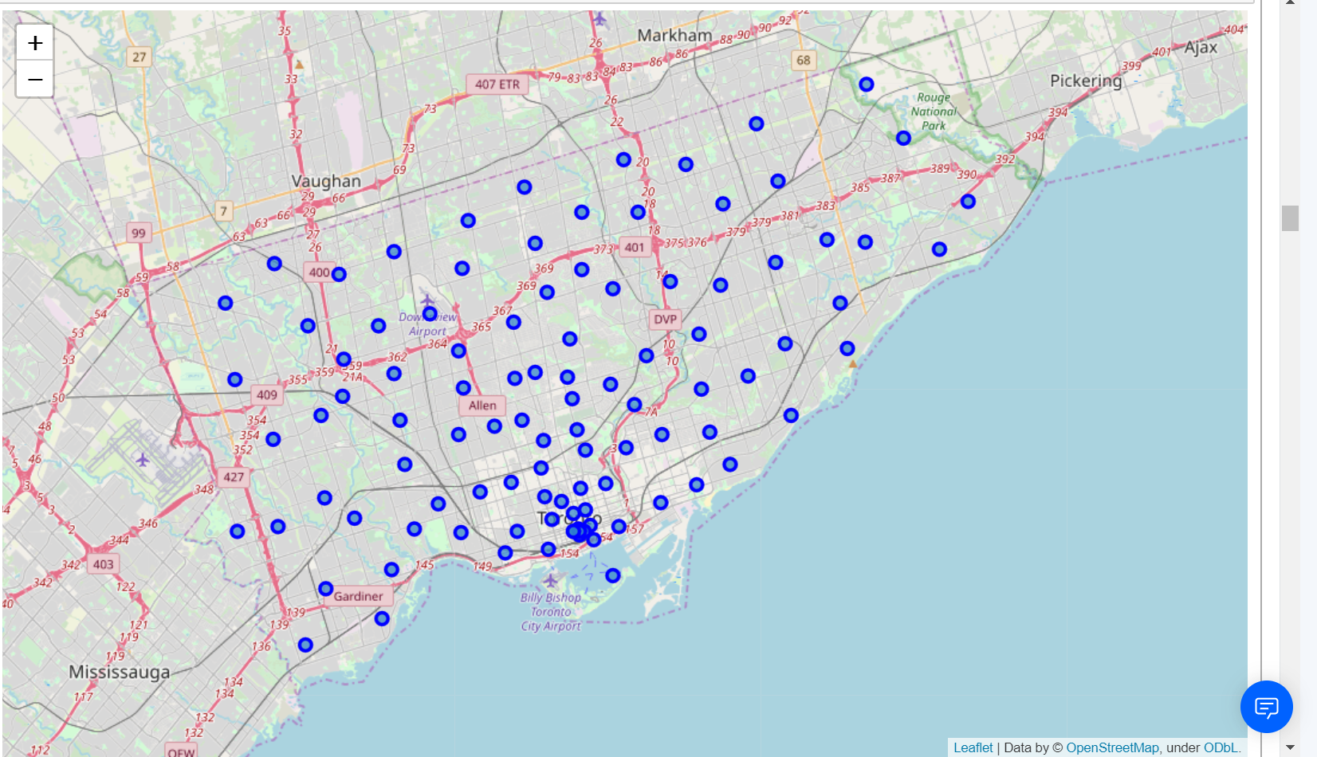
Map of Scarborough

Slide 6
Libraries Which are Used to Develop the Project:
Pandas: For creating and manipulating data frames.
Folium: Python visualization library would be used to visualize the neighborhoods cluster distribution of using interactive leaflet map.
Scikit Learn: For importing k-means clustering.
JSON: Library to handle JSON files.
XML: To separate data from presentation and XML stores data in plain text format.
Geocoder: To retrieve Location Data.
Beautiful Soup and Requests: To scrap and library to handle http requests.
Matplotlib: Python Plotting Module.

Slide 7
Methodology
To compare the similarities of two cities, we decided to explore neighborhoods, segment them, and group them into clusters to find similar neighborhoods.
To be able to do that, we need to cluster data which is a form of unsupervised machine learning: k-means clustering algorithm.
Using credentials of Foursquare API features of near-by places of the neighborhoods would be mined. Due to http request limitations the number of places per neighborhood parameter would reasonably be set to 100 and the radius parameter would be set to 500.

Slide 8
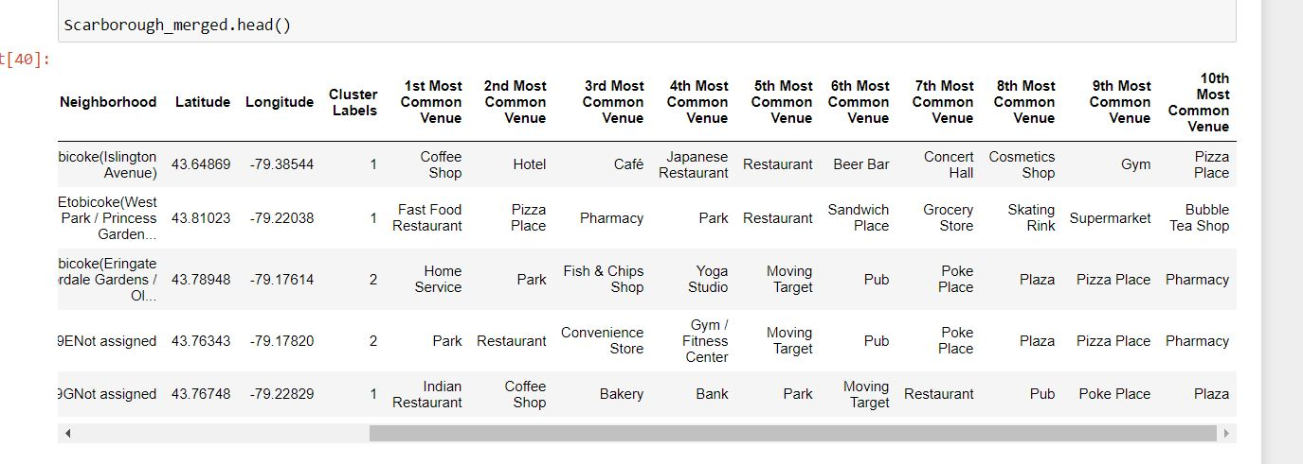
Using K-Means Clustering Approach

Slide 9
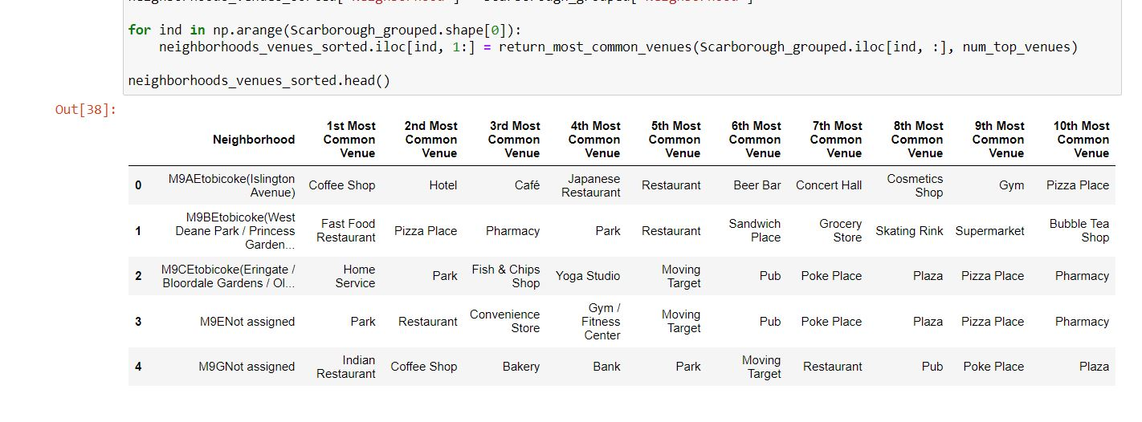
Most Common venues near Neighborhood

Slide 10
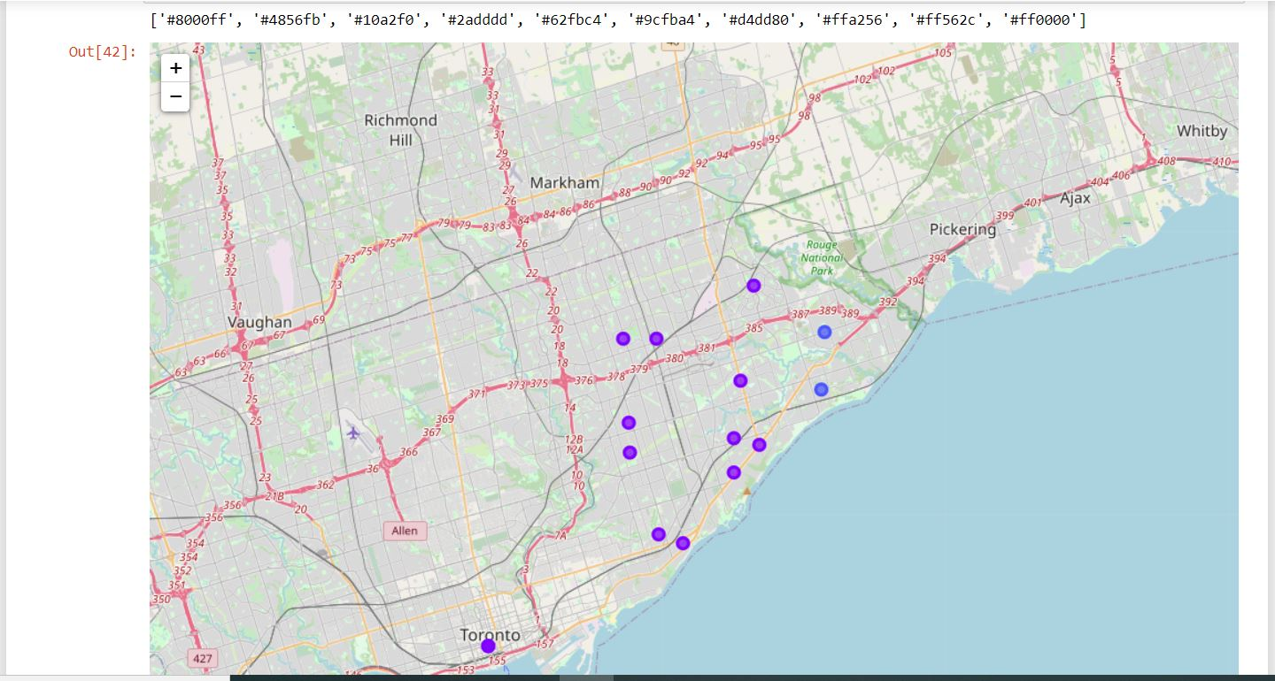
Results
Map of Clusters in Scarborough

Slide 11
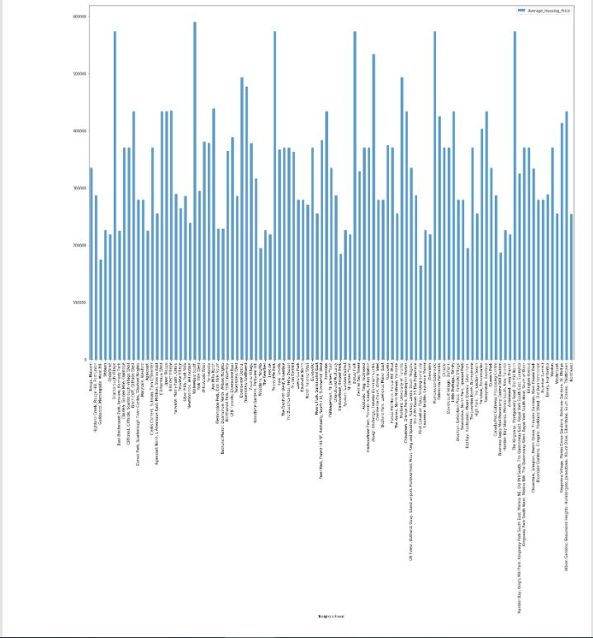
Average Housing Price by Clusters in Scarborough

Slide 12
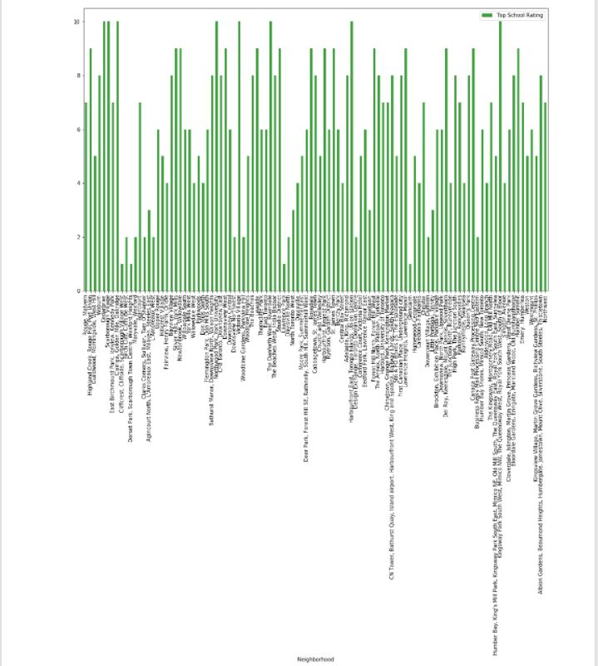
School Ratings by Clusters in Scarborough

Slide 13
Discussion:
The major purpose of this project, is to suggest a better neighborhood in a new city for the person who are shifting to the neighborhoods considering various factors like Social presence in society in terms of like minded people, Connectivity to the airport, bus stand, city center, markets and other daily needs things nearby, etc.
Sorted list of house in terms of housing prices in a ascending or descending order
Sorted list of schools in terms of location, fees, rating and reviews

Slide 14
Conclusion
Thus, in this project, using k-means cluster algorithm I separated the neighborhood into 10 different clusters and for 103 different latitude and longitude from dataset, which have very-similar neighborhoods around them.
Using the charts above results presented to a particular neighborhood based on average house prices and school rating have been made.
The mapping with Folium is a very powerful technique to consolidate information and make the analysis and decision better with confidence.
This project can be continued for making it more precise in terms to find best house in Scarborough. Best means based on all required things(daily needs or things we need to live a better life) around and in terms of cost effective.

Slide 15
THANK YOU

